Slide 1



生醫訊號處理概論
期中報告
EEG-based Brain-Computer Interfaces (BCIs): A Survey of Recent Studies on Signal Sensing Technologies and Computational Intelligence Approaches and Their Applications
報告者：張詠翔 黃奕瑋
指導老師：Dr. 紀虹名

Slide 2


O92
Preliminary Introduction
林進燈

Slide 3
Outline
1
Introduction
2
Advances in Sensing Technologies
3
Signal Enhancement and Online Processing
4
BCI-based Healthcare Systems with AI
5
Conclusion

Slide 4
Part 1
Introduction

Slide 5
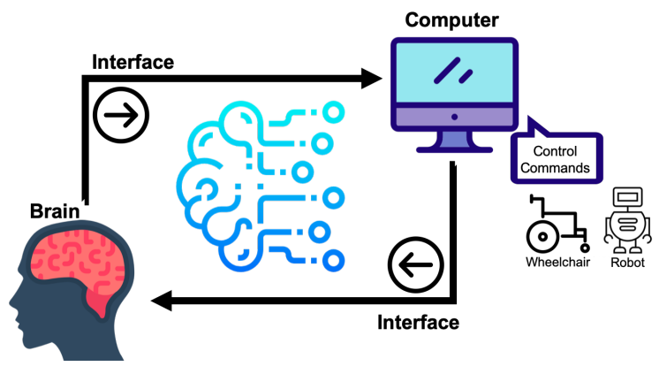
Brain-Computer Interface (BCI) is a powerful communication tool between users and systems, which enhances the capability of the human brain in communicating and interacting with the environment directly.
Introduction
-An Overview of BCI-
Fig. 1. The framework of brain-computer interface (BCI)
1

Slide 6
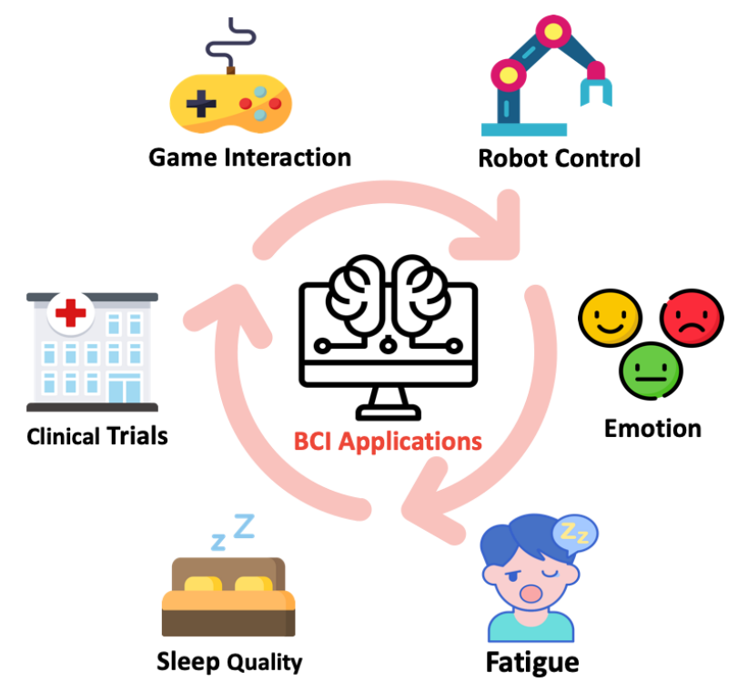
Introduction
-An Overview of BCI-
The research of BCI was first released in the 1970s, addressing an alternative transmission channel without depending on the normal peripheral nerve and muscle output paths of the brain.
Overall, BCIs have contributed to various fields of research.
Fig. 2. BCI contributes to various fields of research
2

Slide 7
Introduction
-Contribution-
The recent (2015-2019) review articles lack a comprehensive survey in recent EEG sensing technologies, signal enhancement for specific BCI applications, in addition to healthcare systems.
In our survey, we aim to address the above limitations and include the recently released BCI studies in 2019.
3

Slide 8
Advances in Sensing Technologies
Part 2

Slide 9
Advances in Sensing Technologies
-An overview of EEG sensors/devices-
Wet sensor technology
For non-invasive EEG measurements, wet electrode caps are normally attached to users’ scalp with gels as the interface between sensors and the scalp.
The application of the gel interface is to decrease the skin-electrode contact interface impedance, which could be uncomfortable and inconvenient for users and can be too time-consuming and laborious for everyday use.
However, without the conductive gel, the electrode-skin impedance cannot be measured, and the quality of measured EEG signals could be compromised.
4

Slide 10
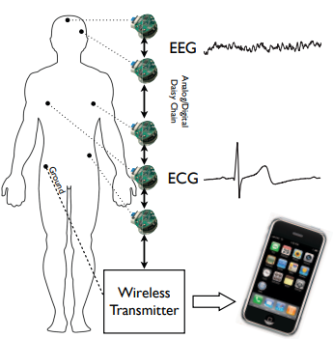
Advances in Sensing Technologies
Fig. 3. Block diagram of wireless BSN
-An overview of EEG sensors/devices-
Dry sensor technology
The major advantages for dry sensors, compared with wet counterparts, is that it substantially enhances system usability, and the headset is very easy to wear and remove, which even allows skilled users to wear it by themselves in a short time.
Chi et al. [1] developed a new integrated sensor controlling the sensitive input node to attain prominent input impedance, with a complete shield of the input node from the active transistor, bond-pads, to the specially built chip package.
[1] Chi et al., "Wireless Non-contact EEG/ECG Electrodes for Body Sensor Networks," 2010 International Conference on Body Sensor Networks, 2010, pp. 297-301, doi: 10.1109/BSN.2010.52.
5

Slide 11
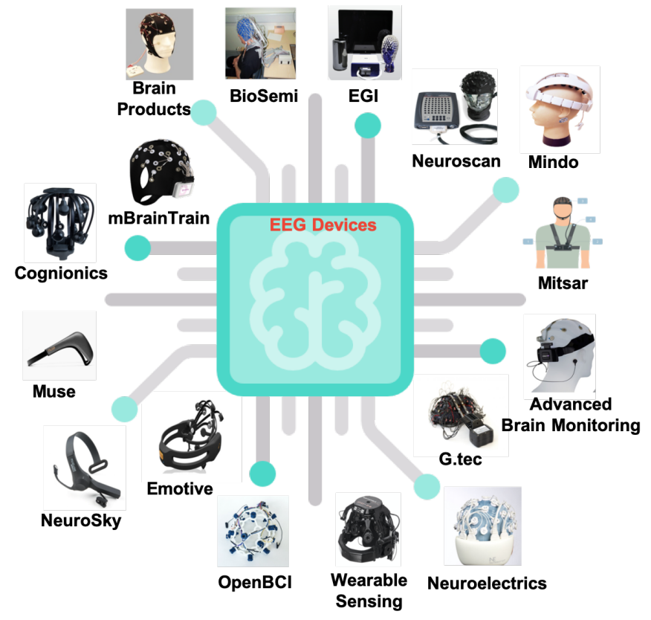
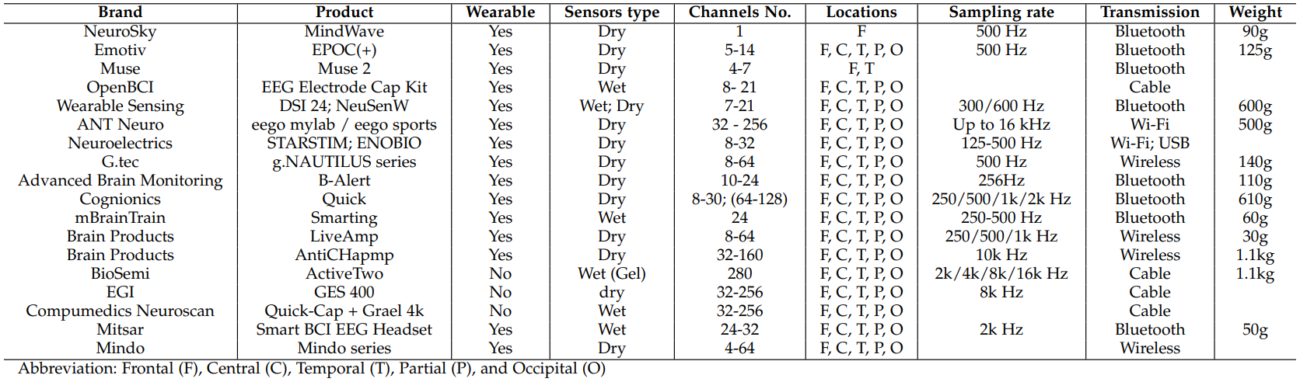
Advances in Sensing Technologies
Fig. 4. lists 21 products of 17 brands with eight attributes providing a basic overview of EEG headsets.
-Commercialized EEG devices-
Fig. 4. Commercialized EEG devices for BCI applications
6

Slide 12
Part 3
Signal Enhancement and Online Processing

Slide 13
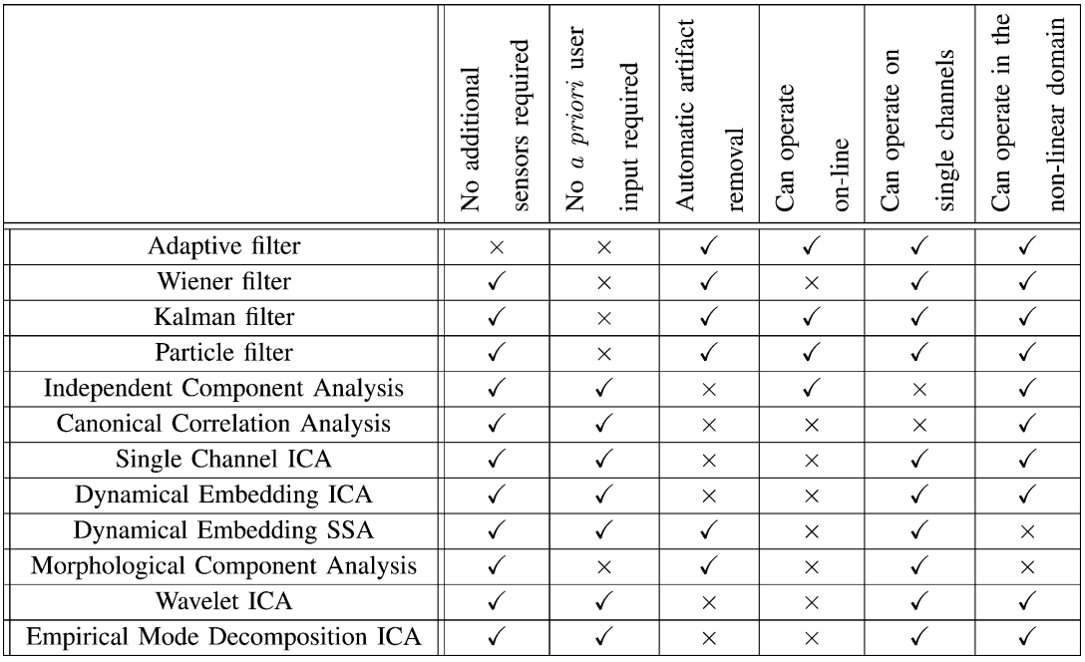
Signal Enhancement and Online Processing
Fig. 5. Comparison of the advantages and disadvantages of various artifact removal techniques [2]
-Artefact handling-
Based on a broad category of unsupervised learning algorithms for signal enhancement, Blind Source Separation (BSS) estimates original sources and parameters of a mixing system and removes the artefact signals, such as eye blinks and movement, and the muscle artefacts.
[2] Sweeney et al., "Artifact Removal in Physiological Signals—Practices and Possibilities," in IEEE Transactions on Information Technology in Biomedicine, vol. 16, no. 3, pp. 488-500, 2012, doi: 10.1109/TITB.2012.2188536.
7

Slide 14
Signal Enhancement and Online Processing
-Eye blinks and movements-
Eye blinks and movements are common artefacts in EEG data.
Artefact subspace reconstruction (ASR) is used for removing large-amplitude or transient artefacts, but it has limitations for single-channel EEG recordings.
ICA-based mechanisms can complement ASR for cleaning EEG signals and effectively remove eye artefacts.
8

Slide 15
Signal Enhancement and Online Processing
-Muscle artefacts-
Muscle artefacts in EEG data can result from muscle contractions and stretches near the recording sites.
Various techniques, including EEMD-CCA, BSS-CCA, and IVA, are used to remove muscle artefacts.
The combination of methods, such as BSS-CCA followed by spectral-slope rejection and IVA, can be effective in removing muscle artefacts.
EEMD-CCA: Combination of the ensembled empirical mode decomposition (EEMD) and Canonical Correlation Analysis (CCA).
BSS-CCA: Combination of the BSS and CCA.
IVA: Independent vector analysis.
9

Slide 16
Part 4
BCI-based Healthcare Systems with AI

Slide 17
BCI-based Healthcare Systems with AI
-Machine Learning-
Machine learning tasks are generally classified into several models, such as supervised learning and unsupervised learning.
Performing machine learning requires to create a model for training purpose.
In EEG-based BCI applications, various types of models have been used and developed for machine learning.
10

Slide 18
BCI-based Healthcare Systems with AI
In the last ten years, the leading families of models used in BCIs include linear classifiers, neural networks, non-linear Bayesian classifiers, nearest neighbour classifiers and classifier combinations.
-Machine Learning-
The linear classifiers, such as Linear Discriminant Analysis (LDA), Regularized LDA, and Support Vector Machine (SVM), classify discriminant EEG patterns using linear decision boundaries between feature vectors for each class.
In terms of neural networks, they assemble layered human neurons to approximate any nonlinear decision boundaries, where the most common type in BCI applications is the Multilayer Perceptron (MLP) that typically uses only one or two hidden layers.
11

Slide 19
BCI-based Healthcare Systems with AI
-Machine Learning-
Considering the physical distances of EEG patterns, the nearest neighbour classifier, such as the k nearest neighbour (kNN) algorithm, proposes to assign a class to the EEG patterns based on its nearest neighbour.
Finally, classifier combinations are combining the outputs of multiple above classifiers or training them in a way that maximizes their complementarity.
12

Slide 20
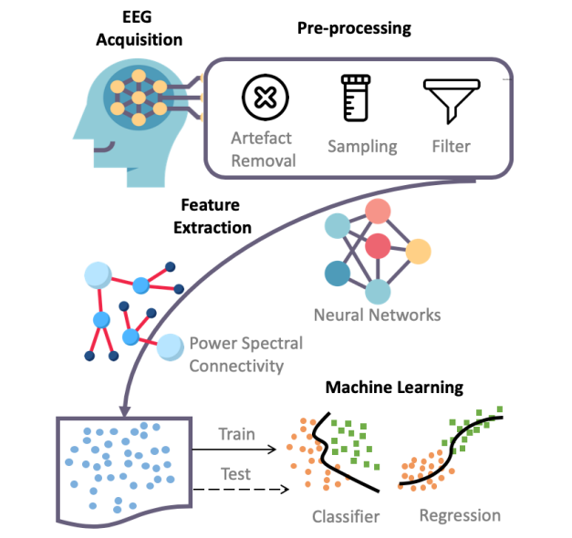
BCI-based Healthcare Systems with AI
-Machine Learning-
Additionally, to apply machine learning algorithms to the EEG data, we need to pre-process EEG signals and extract features from the raw data, such as frequency band power features and connectivity features between two channels.
13

Slide 21
BCI-based Healthcare Systems with AI
-Deep Learning(CNN)-
Deep learning is a specific family of machine learning algorithms in which features, and the classifier are jointly learned directly from data.
The representative architectures of deep learning include Convolutional Neural Networks (CNN), Generative Adversarial Network (GAN), Recurrent Neural Networks (RNN), and broad Deep Neural networks (DNN).
For BCI applications, deep learning has been applied broadly compared with machine learning technology mainly because currently most machine learning research concentrates on static data which is not the optimal method for accurately categorizing the quickly changing brain signals.
14

Slide 22
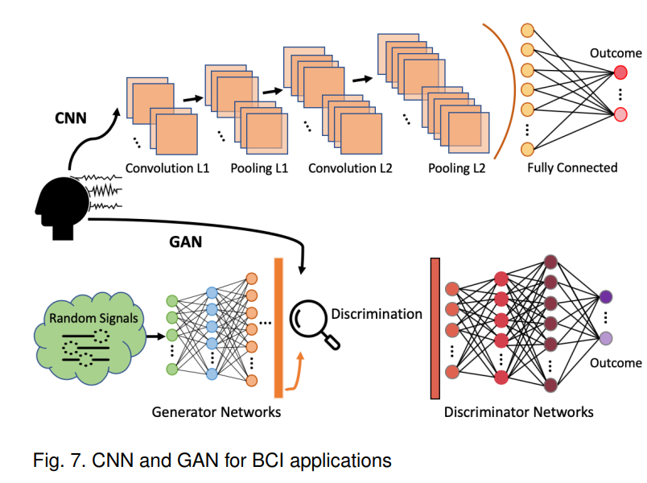
BCI-based Healthcare Systems with AI
-Deep Learning(CNN)-
The nature of CNNs with stacked layers is to reduce input data to easily-identifiable formations with minimal loss, and distinctive spatial dependencies of the EEG patterns could be captured by applying CNN.
In addition to this, the recent five BCI applications employing CNNs in fatigue, stress, sleep, motor imagery (MI), and emotional studies, are reviewed below.
15

Slide 23
BCI-based Healthcare Systems with AI
In classification tasks, a substantial amount of real-world data is required for training machine learning and deep learning modules, and in some cases, there are limitations of acquiring enough amount of real data or simply the investment of time and human resources could be too overwhelming.
-Deep Learning(GAN)-
Proposed in 2014 and becoming more active in recent years, GAN is mainly used data augmentation to address the question of how to generate artificial natural looking samples to mimic real-world data via implying generative models, so that unrevealed training data sample number could be increased.
To the best of our knowledge, in contrast with CNN, GAN was comparatively less studied in BCIs. One major reason is that the feasibility of using GAN for generating time sequence data is yet to be fully evaluated.
16

Slide 24
BCI-based Healthcare Systems with AI
-Deep Learning(RNN)-
Over the past several years, the research of the RNN framework in EEG-based BCIs has increased substantially with many studies showing that the results of RNN-based methods outperform a benchmark or other traditional algorithms or the RNN combined with other deep neural networks such as CNN to optimize performance.
The RNN framework has also been applied to other EEG-based tasks, such as identifying individuals, hand motion identification, sleep staging, and emotion recognition.
17

Slide 25
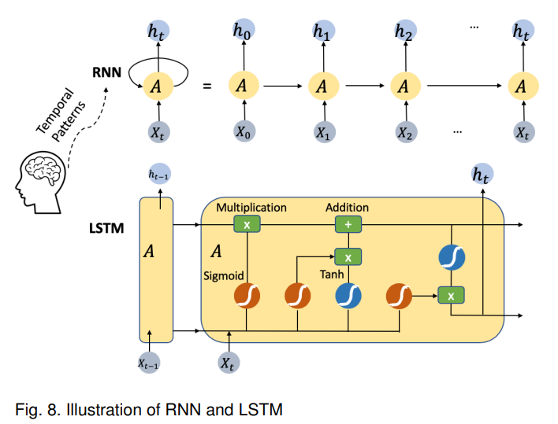
BCI-based Healthcare Systems with AI
-Deep Learning(RNN)-
Other novel framework proposals based on RNN, such as the spatial-temporal RNN (STRNN) for feature learning integration from both temporal and spatial information of the signals, are also being explored in recent years.
18

Slide 26
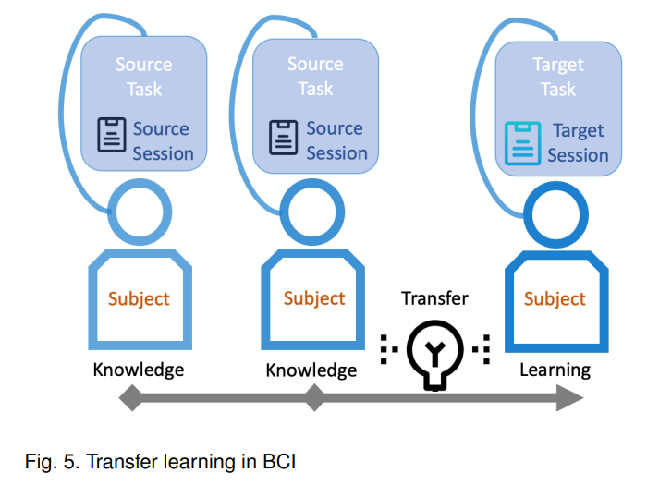
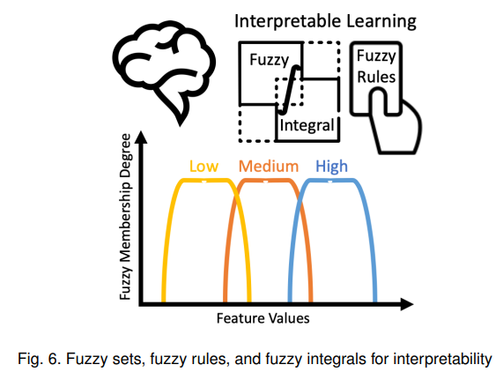
BCI-based Healthcare Systems with AI
-Theory-
Transfer Learning In BCI
Fuzzy sets, fuzzy rules, and fuzzy integrals for interpretability
19

Slide 27
Part 5
Conclusion

Slide 28
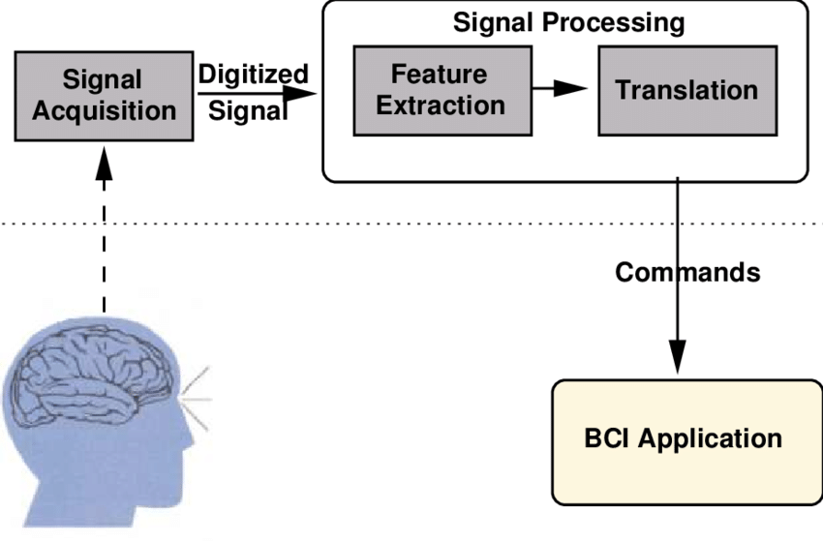
Conclusion
-An overview of EEG sensors/devices-
It would be encouraging to pursue experiments with adaptive EEGbased BCI training.
Integrating BCI with other technical or physiological signals, which is hybrid BCI system, would be a future focus of research for improving classification accuracy and general outcomes.
20

Slide 29



Conclusion
Previous researches have been inducing one popular protocol used in exogenous BCIs, with visual stimulus from AR glasses such as smart glasses used in, and capturing the response by measuring EEG signals to perform tasks.
The scientific community is also investigating enhanced conjunction of technology and interface for HCI that is the combination of Augmented Reality (AR) and EEG-based BCI.
With the accessibility of AR and commercialised noninvasive BCI devices, using AR and EEG devices, augmentation becomes feasible and also effective in outcomes.
21

Slide 30

Conclusion
Finally, recent research has shown that：
deep learning (and even traditional machine learning) models in EEG-based BCIs are vulnerable to adversarial attacks, and there is an urgent need to develop strategies to defend such attacks.
22

Slide 31
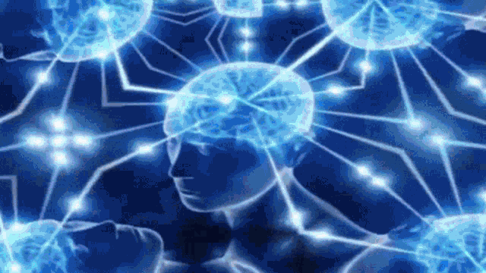
Thanks

